Slide 1
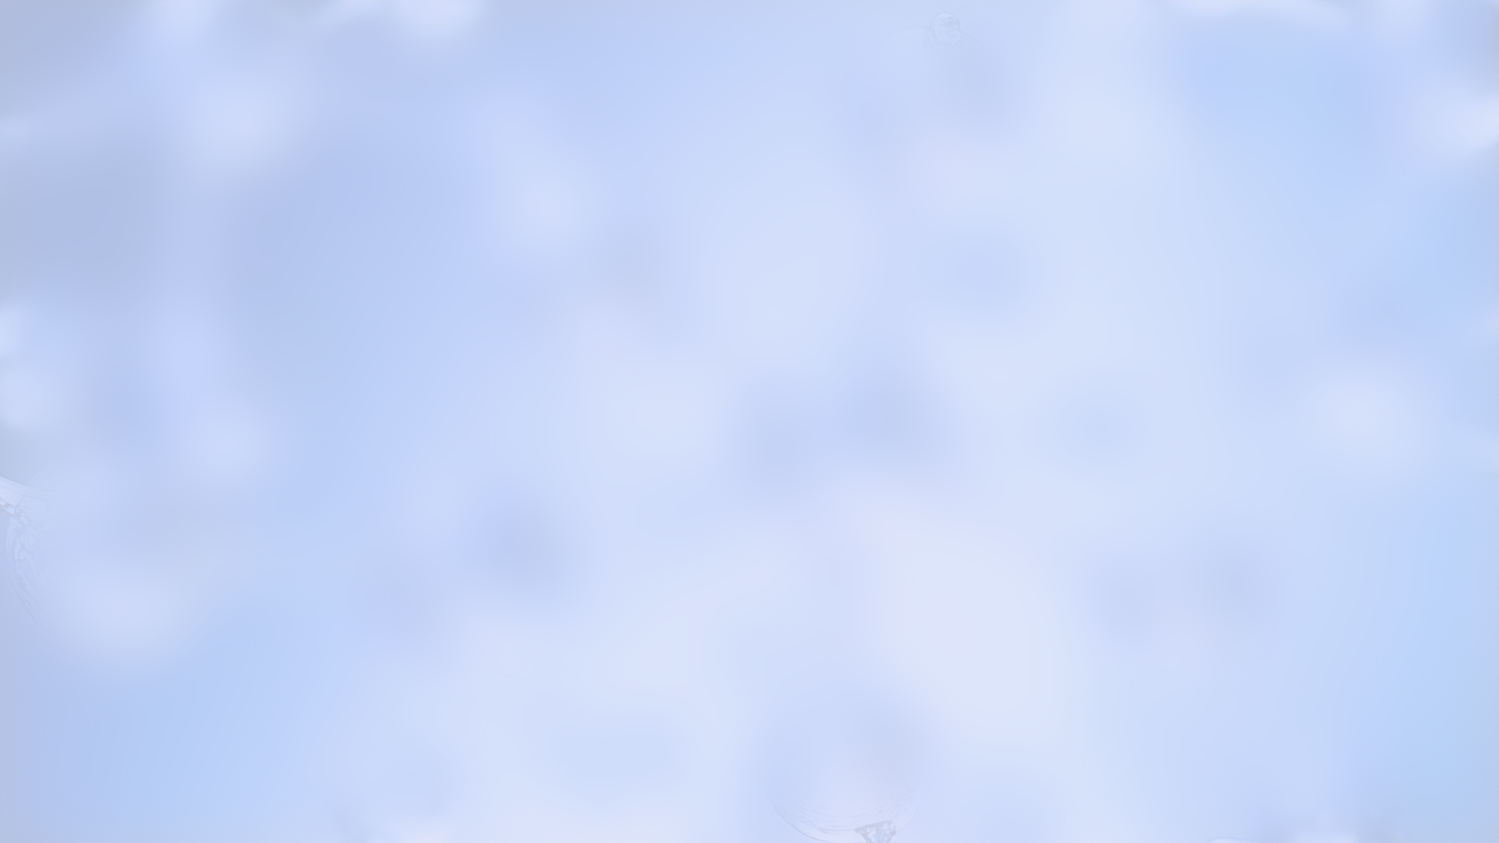
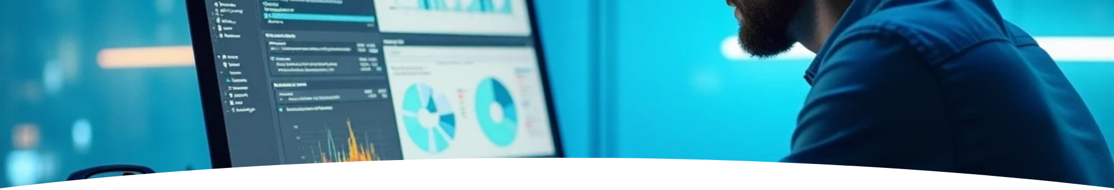

Data Acquisition and Pre-processing
Author: Landry CYIZA MPAYIMANA
ETEFOP TSS

Slide 2

CONTENTS
1. Data Collection (5 Marks)
2. Data Pre-processing (10 Marks)

Slide 3

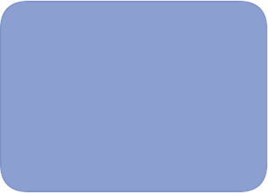
01
Data Collection (5 Marks)

Slide 4
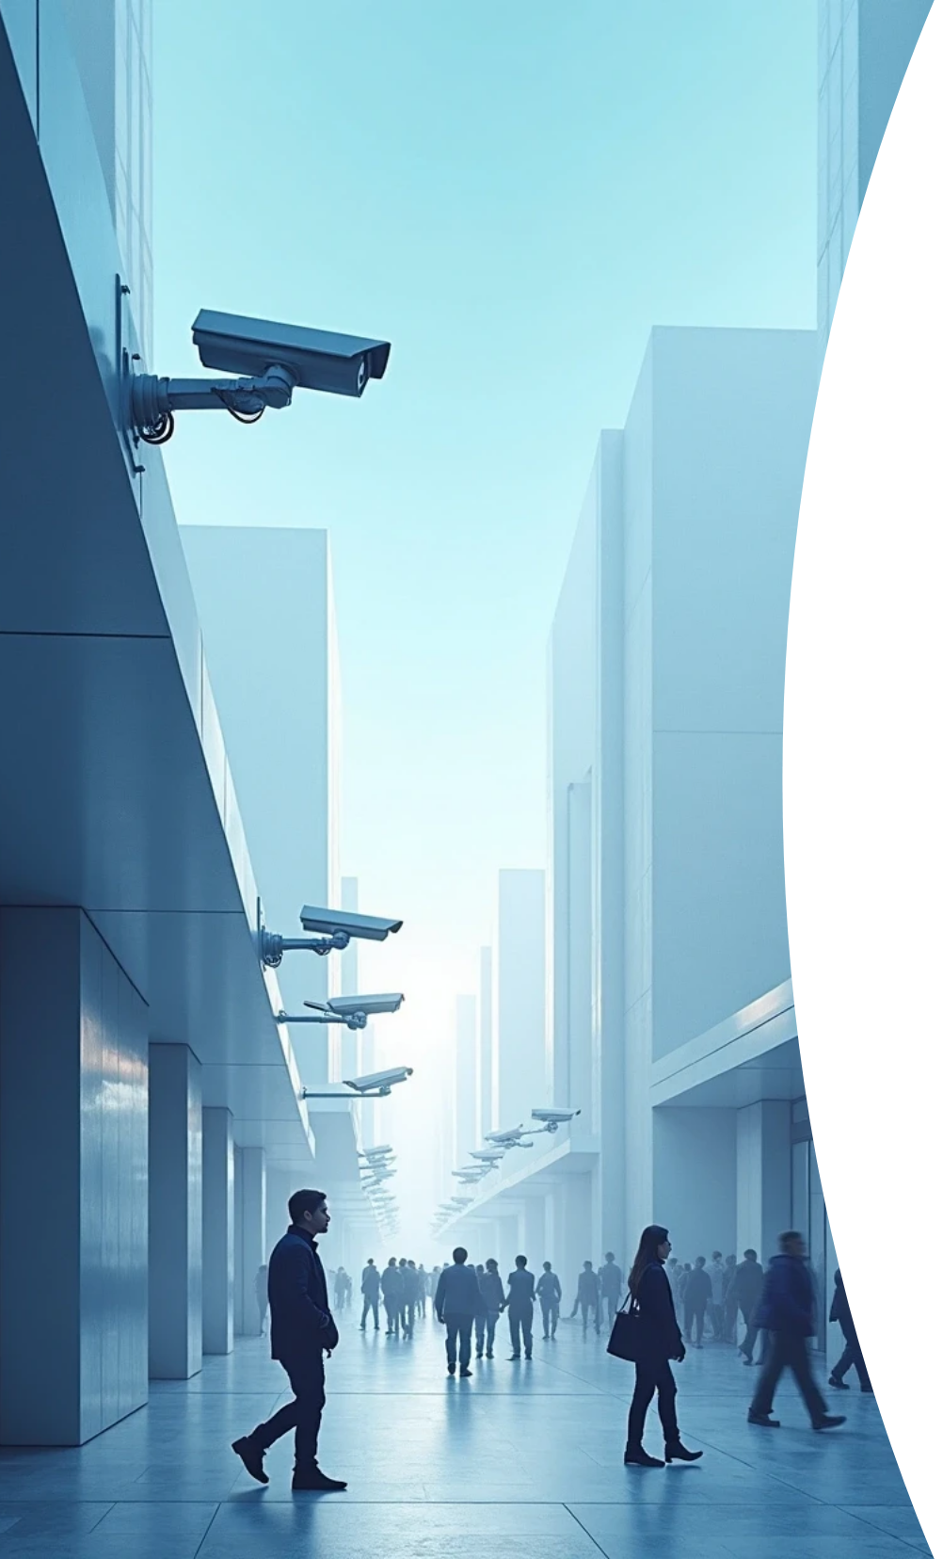
AI Data Category (1 Mark)
Since the Smart Surveillance System uses cameras to identify objects, the AI needs visual information.
Answer: The appropriate data category for this project is Image Data (or Visual Data).

Slide 5

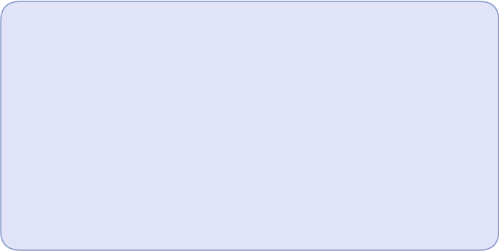
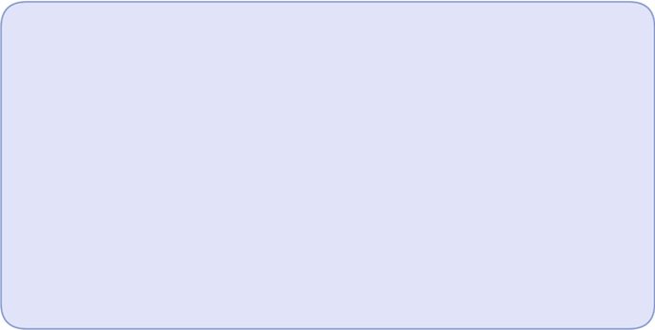

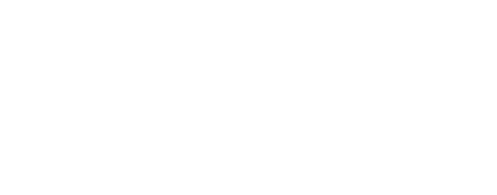
Two Distinct AI-Data Collection Techniques (4 Marks)
These are the primary methods you use to gather the raw photos of humans and pets:
1
2
Technique 1
Technique 2
Real-Time/Field Data Capture: You use the actual camera you'll deploy (like an ESP32 or Raspberry Pi) to record footage in the real environment (e.g., the storeroom). This captures unique things like shadows and low-light conditions.
Leveraging Open-Source Datasets: You download large, high-quality, pre-labeled collections of images that are freely available online (e.g., from public research databases).
• Python Application: You use Python libraries like requests or simple file download scripts. This is a fast way to get thousands of already-labeled images to make your model strong and diverse from the start.
• Python Application: We use libraries like OpenCV (cv2) in Python. This library lets your code "talk" to the camera, tell it to take a picture, and save the picture file to your computer.

Slide 6
02
Data Pre-processing (10 Marks)

Slide 7

Data Pre-processing (10 Marks)
Data Pre-processing is the crucial phase of taking raw, messy collected data and making it clean, consistent, and numerical so the AI model can successfully learn from it.

Slide 8
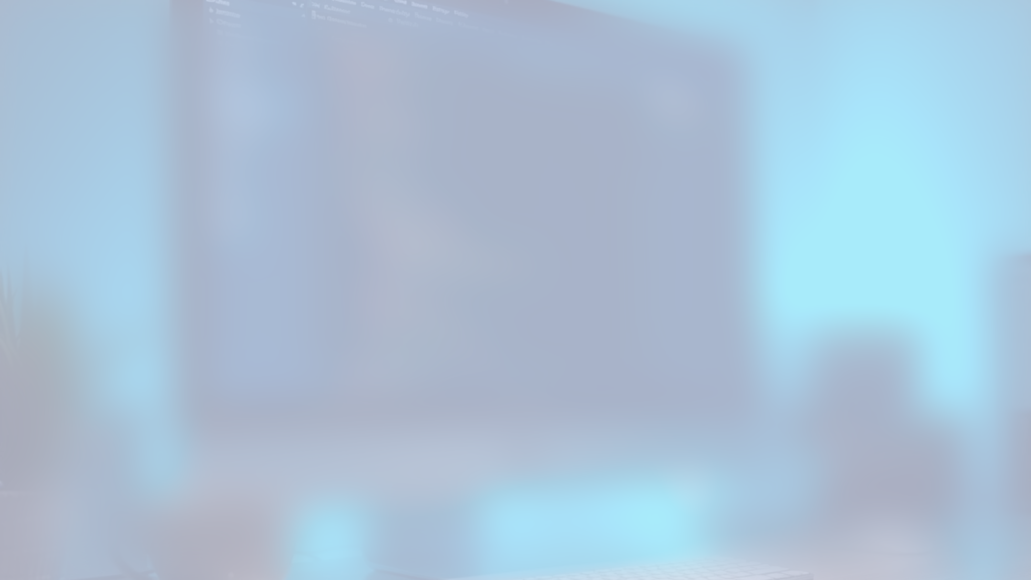
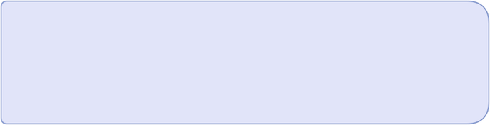
Cleaning (3 Marks)
Purpose
Specific Example (Image Dataset)
To find and eliminate errors, corrupt files, or totally unusable images in your dataset. If you train a model on bad data, you will get bad results (Garbage In, Garbage Out).
Removing images that are completely blurry, totally black, or corrupted (the file won't open).
Python Code:

Slide 9
# Cleaning Example: Checking if an image file is usable
from PIL import Image # The PIL library is great for basic image checks
try:
# 1. Try to open the file
img = Image.open("corrupt_pet_photo.jpg")
# 2. Force a check on the file's structure
img.verify()
print("Image is clean and verified.")
except Exception as e:
# 3. If there is an error, this file is corrupted and must be removed
print(f"ERROR! Image is corrupt. It must be deleted. Details: {e}")

Slide 10

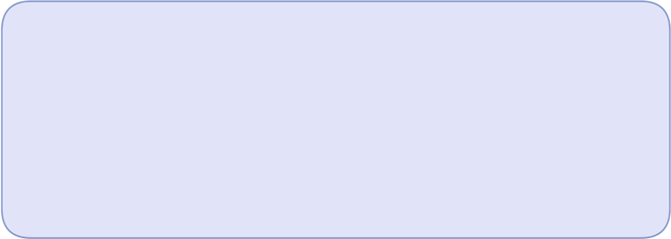
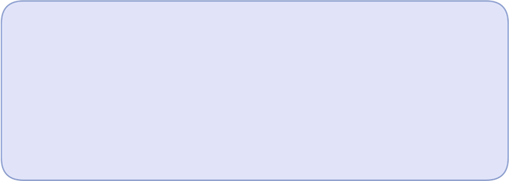
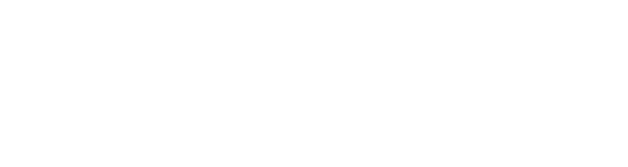
Filtering (3 Marks)
1
2
Purpose
Specific Example (Image Dataset)
To select only the data that is directly relevant to your specific goal (differentiating humans and pets). You remove noise and irrelevant content.
If your data collection accidentally picked up images of cars, boxes, or office equipment, you must filter them out. The model should only see the two classes it needs to learn: Human and Pet.
Python Code:
image_label = "Tree" /# Assume this label was read from your collected data /# We only want 'Human' or 'Pet' images for the Smart Surveillance System: if image_label in ['Human', 'Pet']: print(f"Label '{image_label}' is relevant. KEEP this image.") else: /# This image is useless for the model's job. print(f"Label '{image_label}' is irrelevant. DISCARD this image.")

Slide 11
# Filtering Example: Selecting only images with the correct label
image_label = "Tree" # Assume this label was read from your collected data
# We only want 'Human' or 'Pet' images for the Smart Surveillance System:
if image_label in ['Human', 'Pet']:
print(f"Label '{image_label}' is relevant. KEEP this image.")
else:
# This image is useless for the model's job.
print(f"Label '{image_label}' is irrelevant. DISCARD this image.")

Slide 12
Data Transformation (4 Marks)
Purpose
To convert all the clean data into a standard, numerical format that the AI algorithm can process using mathematics.
Transformation Type | Description (Why it's needed) | Python Application (How the code transforms it)
Resizing (Standardization) | All images must be forced to the exact same size (e.g., 224x224 pixels). This ensures the AI model has a consistent input shape every time. | Use OpenCV (cv2.resize) to change the dimensions of the numerical image array.
Normalization (Scaling) | Computers see pixel colors as numbers ranging from 0 to 255. We must scale these values down to the range 0.0 to 1.0. This simple math helps the model train much faster and more accurately. | Divide every pixel value in the image array by 255.
Python Code:

Slide 13
# Data Transformation Example: Resizing and Normalization
import cv2
import numpy as np # NumPy is used for all heavy math and array handling
# 1. Load the image (cv2 reads it as a numerical array with values 0-255)
img_array = cv2.imread("clean_pet_image.jpg")
# --- Resizing (Standardization) ---
# We force the image to be 224 pixels wide and 224 pixels tall.
target_size = (224, 224)
resized_img = cv2.resize(img_array, target_size)
# --- Normalization (Scaling) ---
# 2. Change data type to float (decimal)
normalized_img = resized_img.astype('float32')
# 3. Divide every number by 255 to scale it to the 0.0-1.0 range
normalized_img = normalized_img / 255.0
print(f"Image is ready! Final Shape: {normalized_img.shape}")

Slide 14

Thank You

